Slide 1
Chi Squared Test and ANOVA Test
Rabail Tahir

Slide 2
What is Chi Test and where is it used?
The Chi-Squared Test is a statistical test used to compare observed data with expected data to determine whether they differ significantly.
It helps to find out whether a difference between two categorical variables is due to chance or a relationship between them.
The goal is to identify any difference between actual and predicted data.
The goal is also to identify whether the difference is due to random luck/chance or is there any variable influencing the results.
“A chi-square test or comparable nonparametric test is required to test a hypothesis regarding the distribution of a categorical variable. Categorical variables, which indicate categories such as animals or countries, can be nominal or ordinal. They cannot have a normal distribution since they can only have a few particular values”.
https://www.simplilearn.com/tutorials/statistics-tutorial/chi-square-test

Slide 3
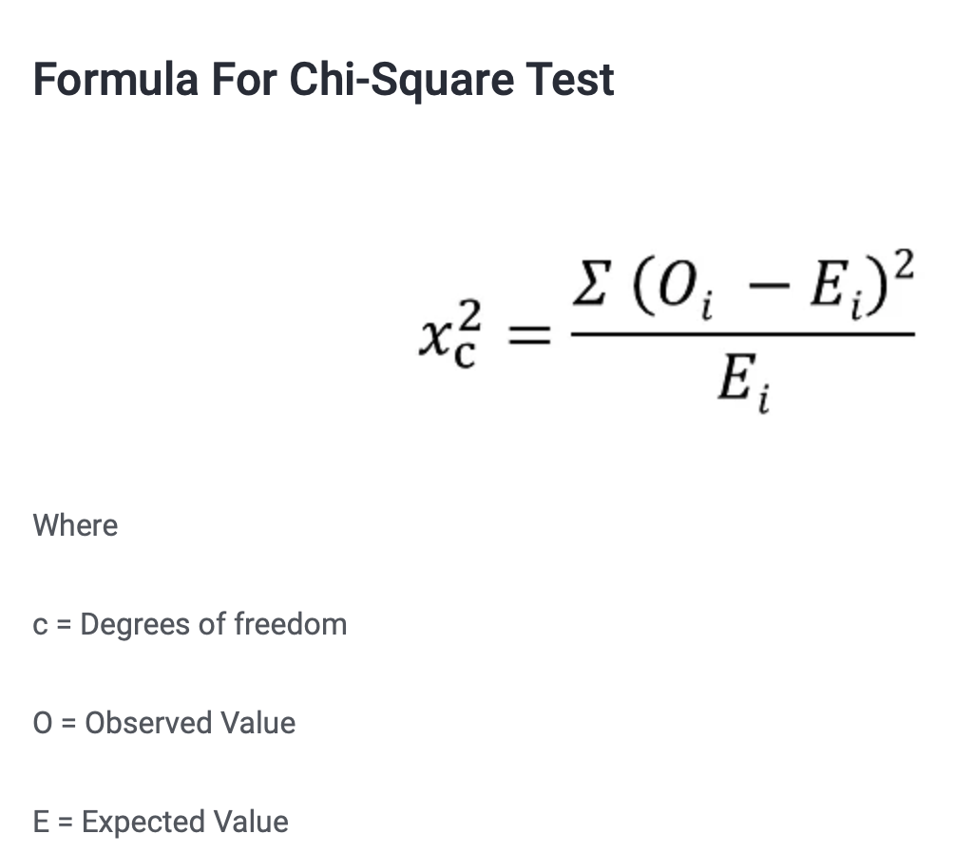

Slide 4
Types of Chi squared Test
There are two types of Chi-Squared Tests:
Goodness-of-Fit Test
Test of Independence

Slide 5
Goodness of fit test
The Goodness-of-Fit Test is used to determine whether the observed data fits a particular distribution.
The test involves comparing the observed frequencies of different categories with the expected frequencies of those categories.
The Observed values are those you gather yourselves.
The expected values are the frequencies expected, based on the null hypothesis.

Slide 6
Example
Example: A study is conducted to test whether the distribution of blood types in a population follows the expected distribution of blood types in the general population.
The expected distribution of blood types in the general population is O (45%), A (40%), B (11%), and AB (4%).
The observed distribution of blood types in the study population is O (50%), A (35%), B (10%), and AB (5%).
We can use the Chi-Squared Test to determine whether the observed distribution of blood types in the study population fits the expected distribution.

Slide 7
Test of Independence
The Test of Independence is used to determine whether there is a significant association between two categorical variables.
The test involves comparing the observed frequencies of different categories of the two variables with the expected frequencies of those categories if the two variables were independent.

Slide 8
Example
Example: A study is conducted to test whether there is a significant association between smoking status (smoker vs. non-smoker) and lung cancer.
We can use the Chi-Squared Test to determine whether there is a significant association between smoking status and lung cancer.

Slide 9
Calculation of Chi-Squared Statistic
The Chi-Squared Test involves calculating the Chi-Squared Statistic (χ²).
The formula for the Chi-Squared Statistic is:
χ² = Σ (Observed - Expected)² / Expected
Where:
Σ = the sum of
Observed = the observed frequency of a category
Expected = the expected frequency of a category

Slide 10
Calculation of Expected Frequencies
To calculate the expected frequencies, we use the formula:
Expected = (row total * column total) / total

Slide 11
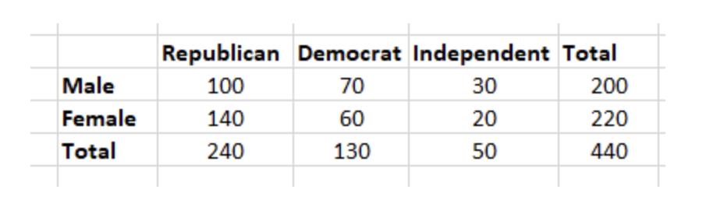
Example- Chi Squared test
Let's say you want to know if gender has anything to do with political party preference. You poll 440 voters in a simple random sample to find out which political party they prefer. The results of the survey are shown in the table below:

Slide 12
To see if gender is linked to political party preference, perform a Chi-Square test of independence using the steps below.
Step 1: Define the Hypothesis
H0: There is no link between gender and political party preference.
H1: There is a link between gender and political party preference.

Slide 13


Step 2: Calculate the Expected Values
Now you will calculate the expected frequency.
For example, the expected value for Male Republicans is:

Slide 14
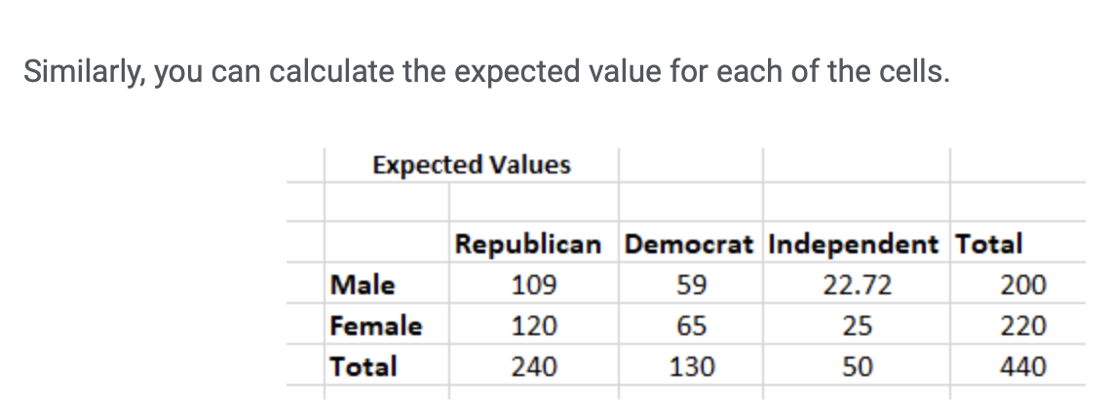

Slide 15
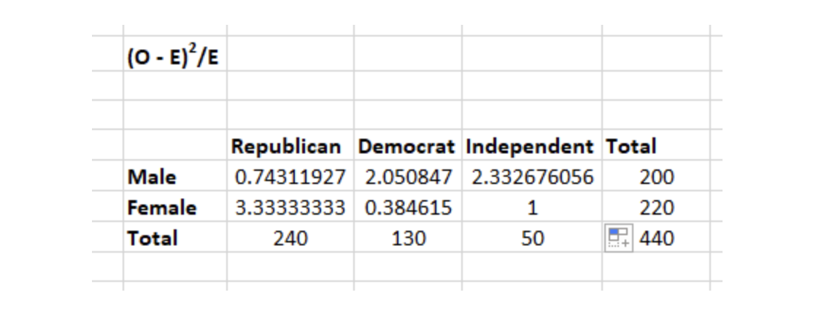
Step 3: Calculate (O-E)2 / E for Each Cell in the Table
Now you will calculate the (O - E)2 / E for each cell in the table.
Where
O = Observed Value
E = Expected Value

Slide 16
Step 4: Calculate the Test Statistic X2
X2 is the sum of all the values in the last table
= 0.743 + 2.05 + 2.33 + 3.33 + 0.384 + 1
= 9.837

Slide 17
Results
Before you can conclude, you must first determine the critical statistic, which requires determining our degrees of freedom. The degrees of freedom in this case are equal to the table's number of columns minus one multiplied by the table's number of rows minus one, or (r-1) (c-1). We have (3-1)(2-1) = 2.
Finally, you compare our obtained statistic to the critical statistic found in the chi-square table. As you can see, for an alpha level of 0.05 and two degrees of freedom, the critical statistic is 5.991, which is less than our obtained statistic of 9.83. You can reject our null hypothesis because the critical statistic is higher than your obtained statistic.
This means you have sufficient evidence to say that there is an association between gender and political party preference.

Slide 18
Steps of Chi squared Test
The steps of a chi test are as follows:
State the null and alternative hypotheses
Select the appropriate chi-square test
Calculate the expected frequencies
Calculate the chi-square statistic
Calculate the degrees of freedom
Determine the critical value
Compare the critical value with the calculated chi-square statistic
Draw a conclusion

Slide 19
Pros and Cons
Pros:
It is easier to compute.
It can also be used with nominal data.
It does not assume anything about the data distribution.
Cons:
The number of observations should be more than 20.
Data must be frequency data.
It assumes random sampling. It means the sample should be selected randomly.
It is sensitive to small frequencies, which leads to erroneous conclusions.
It is also sensitive to sample size.

Slide 20
ANOVA Test
Analysis of Variance Test, is a set of procedures used to analyze the differences in means of different groups.
For example:
A group of psychiatric patients are trying three different therapies: counseling, medication and biofeedback. You want to see if one therapy is better than the others.
A manufacturer has two different processes to make light bulbs. They want to know if one process is better than the other.
Students from different colleges take the same exam. You want to see if one college outperforms the other.

Slide 21
One-Way and Two-Way ANOVA Test
One-way and Two-way refers to the amount of variables in your data.
One-way has one independent variable . For example: brand of cereal,
Two-ways has two independent variables. For example: brand of cereal, calories.
Groups or levels are different groups within the same independent variable, for example brand of cereal can have 2 groups, lucky charms and Kellogs.

Slide 22
One way ANOVA test example
A study is conducted to test whether there are significant differences in the mean height of people from three different regions: North, South, and West.
The following table shows the mean height and standard deviation of each group:
North | 172.5 | 6.7
South | 167.8 | 8.2
West | 170.2 | 5.5
We can use One-Way ANOVA to determine whether there are significant differences in the mean height of people from these three regions.

Slide 23
Calculation of Sum of Squares Total (SST)
The total variation in the data can be represented by the Sum of Squares Total (SST).
The formula for SST is:
SST = Σ (X - X̄)²
Where:
Σ = the sum of
X = an individual value in the dataset
X̄ = the mean of all the values in the dataset

Slide 24
Calculation of Sum of Squares Within (SSW)
The variation within each group can be represented by the Sum of Squares Within (SSW).
The formula for SSW is:
SSW = Σ (Xi - X̄i)²
Where:
Σ = the sum of
Xi = an individual value in a particular group
X̄i = the mean of all the values in that group

Slide 25
Calculation of Sum of Squares Between (SSB)
The variation between the groups can be represented by the Sum of Squares Between (SSB).
The formula for SSB is:
SSB = Σ Ni (X̄i - X̄)²
Where:
Σ = the sum of
Ni = the number of values in a particular group
X̄i = the mean of all the values in that group
X̄ = the overall mean of all the values in the dataset

Slide 26
Degrees of Freedom
Degrees of Freedom (df) is a measure of the number of independent pieces of information that went into the estimate of a parameter.

Slide 27
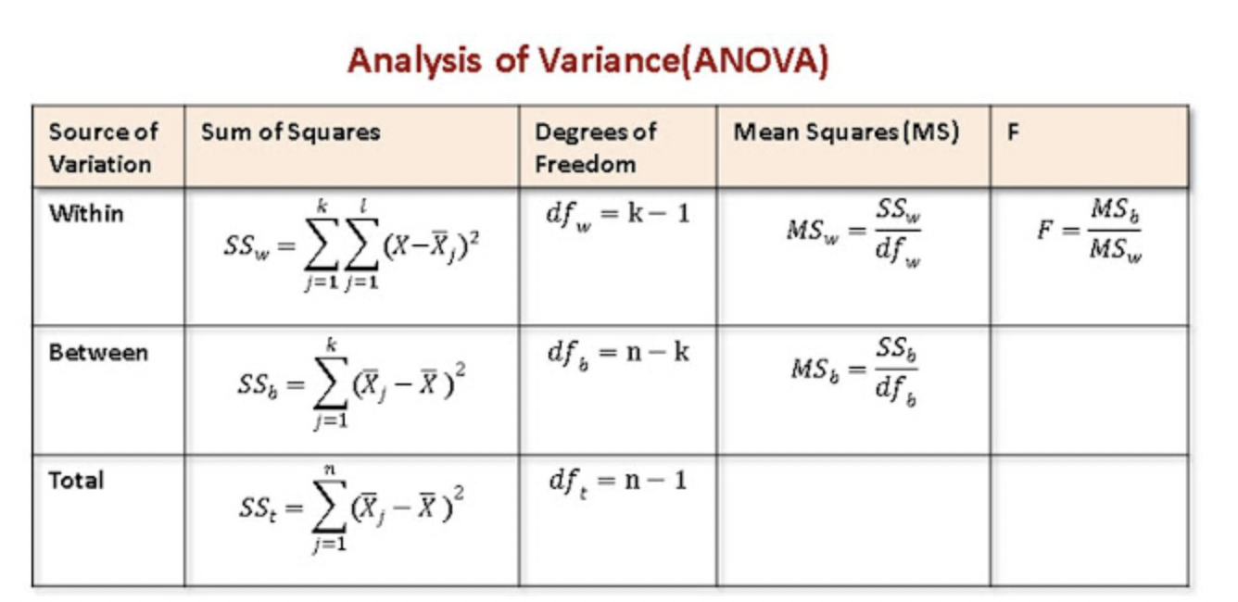

Slide 28
ANOVA Test Steps
Step 1: State the null and alternative hypotheses.
The null hypothesis is that there are no significant differences between the means of the groups.
The alternative hypothesis is that at least one group has a significantly different mean than the others.
Step 2: Check assumptions.
There are several assumptions that need to be checked before performing ANOVA, including:
Normality: The data should be normally distributed within each group.
Homogeneity of variances: The variances should be equal across all groups.
Independence: The observations in each group should be independent of each other.
Step 3: Calculate the test statistic.
The test statistic for ANOVA is the F-statistic, which is calculated as the ratio of the variance between the groups to the variance within the groups.

Slide 29
Step 4: Determine the p-value.
The p-value is the probability of obtaining a test statistic as extreme or more extreme than the observed value, assuming the null hypothesis is true.
Step 5: Make a decision.
If the p-value is less than the chosen level of significance (usually 0.05), we reject the null hypothesis and conclude that there are significant differences between the means of the groups.
If the p-value is greater than the chosen level of significance, we fail to reject the null hypothesis and conclude that there is not enough evidence to suggest that there are significant differences between the means of the groups.
Step 6: Interpret the results.
If we reject the null hypothesis, we need to investigate further to determine which groups have significantly different means from each other.
We can use post-hoc tests, such as Tukey's HSD test or the Bonferroni correction, to identify significant differences between pairs of groups.

Slide 30
Questions?

